Slide 1
The Review Battle
Reid vs Haley
Fall 2017

Slide 2
Rules
Every student must participate in the Review Battle.
If a student refuses to participate then they will forfeit a point to the other team every time it’s their turn.
One student from each class will stand behind their teacher’s podium.
The other students will be seated to the side of the podiums. Out of the way

Slide 3
Rules Cont.
A question will be posted on the board.
The student to signal for the answer first will answer. If the answer is wrong then the other student gets a chance. (45- second limit)
A student must get approval from Reid or Haley to say their answer. Blurting out the answer will automatically give the other team a point.

Slide 4
Rules Cont.
The students can only give one answer.
If a correct answer is not given the two students will sit back down and no points are awarded.
If a student from the desk blurts out anything a point will be awarded to the other team.

Slide 5
Point System
There will be 3 Rounds.
1st Round
40 Multiple Choice Questions
Worth 1 point
2nd Round
20 Political cartoons
Worth 3 points
3rd Round
50 Short Answer Questions
Worth 5 points
Correct team gets to shoot basketball for another point

Slide 6
Rules Cont.
Reid and Haley are the game administrators
No arguing with the game administrators
If a student is kicked out of the game by an administrator points will be added every time that student is up to answer.
A team will be forced to forfeit if the administrators feel like a team is cheating.

Slide 8
Round 1
40 Multiple Choice Questions
Worth 1 point
45 sec time limit
Questions will be in Blue and Answer in Red

Slide 9
Question #1

Slide 10
Q= Few restrictions were placed on immigration to the United States in the late 19th century primarily because immigrants
A. Would work for low wages.
B. Provided a rich source of investment.
C. Would add to the diversity of the population.
D. Faced little opposition from citizens

Slide 11
Answer
A. Would work for low wages.

Slide 12
Question #2

Slide 13
Q= Based on the Populist arguments, how would the economy in the late 1800s have been affected by those in debt?
A .Labor costs would have decreased.
B. Interest rate would have decreased.
C. Product prices would have increase.
D. Consumer demand would have increased.

Slide 14
Answer
C. Product prices would have increase.

Slide 15
Question #3

Slide 16
Q= Which of the following occurred as a result of the Sherman Antitrust Act?
Workers secured a greater share of company profits.
The influence of labor unions on factory owners was reduced.
C. The federal government could dissolve business monopolies.
D. Businesses were required to pay fees to open overseas locations.

Slide 17
Answer
C. The federal government could dissolve business monopolies.

Slide 18
Question #4

Slide 19
This statement could have been made by a historian.
Q=What action from World War II would support this statement?
A. Largenumbers of women went to work in factories war goods
B. Japanese Americans on the West Coast were forced into internment camps
C. Citizens were encouraged to ration food and recycle materials that could be used overseas
D. Significant portions of the African American population moved to northern cities

Slide 20
Answer
B. Japanese Americans on the West Coast were forced into internment camps

Slide 21
Question #5

Slide 22
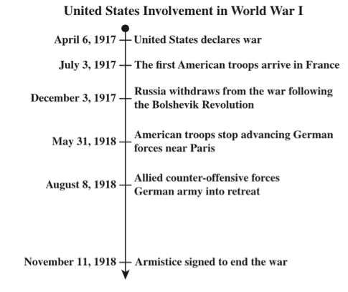
This timeline documents major events in United States involvement in World War I.
Q=Which conclusion can be drawn from the timeline?
A. Germany proposed a separate peace settlements with the United States.
B. The transfer of German forces away from Russia weakened the Allies.
C. The entry of the United States into the war contributed to the Allied victory.
D. Russia withdrew from the war in order to clear the way for a French victory.

Slide 23
Answer
C. The entry of the United States into the war contributed to the Allied victory.

Slide 24
Question #6

Slide 25
Q=What prompted many industrialists to support open immigration policies in the late 1800s?
A. Industrialists got most of their new innovations from immigrants. B. Most immigrants were wealthy and willing to invest in new industries.
C. Immigrants provided a large source of inexpensive labor.
D. Industrialists needed skilled workers to serve in management roles.

Slide 26
Answer
C. Immigrants provided a large source of inexpensive labor.

Slide 27
Question #7

Slide 28
Q=What was the major goal of the Progressive Movement?
A. To replace capitalism with socialism.
B. To fight the growing problem of crime in cities.
C. To protect citizens through government regulation.
D. To end segregation in public facilities.

Slide 29
Answer
C. To protect citizens through government regulation

Slide 30
Question #8

Slide 31
Q=Which statement presents a justification of American imperialism during the late nineteenth century?
A. Leaders believed distant territories were important to long-term national security.
B. Leaders believed the country should avoid getting entangled in European affairs.
C. Leaders believed it was necessary to trade with Europe for military technology.
D. Leaders believed it was wrong to impose American ideals on other cultures.

Slide 32
Answer
A. Leaders believed distant territories were important to long-term national security.

Slide 33
Question #9

Slide 34
Q=The Roosevelt Corollary was meant to
A. Settle international conflict in Asia.
B. Support building of the Panama Canal.
C. Discourage European interference in the Western Hemisphere, specifically Latin America.
D. Provide Cuba’s independence from the U.S.

Slide 35
Answer
C. Discourage European interference in the Western Hemisphere, specifically Latin America.

Slide 36
Question #10

Slide 37
Q=Which of the following was a defining characteristic of the United States during the 1930s?
A. A sharp increase in the power given to state governments
B. An extended period of economic depression
C. The adoption of an interventionist foreign policy
D. The formation of a national civil rights

Slide 38
Answer
B. An extended period of economic depression

Slide 39
Question #11

Slide 40
Q=Why did critics of the Hawley-Smoot Tariff claim it hurt U.S. interests?
A. The tariff damaged economic relations with other countries
B. The tariff did not focus on a broad spectrum of the economy
C. The domestic economy suffered as international trade expanded
D. The farm sector was not protected under the original goal of the bill

Slide 41
Answer
A. The tariff damaged economic relations with other countries

Slide 42
Question #12

Slide 43
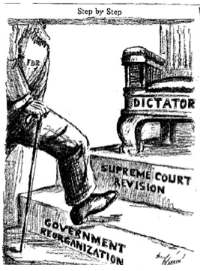
Q=The creator of this political cartoon was expressing his concerns about
A. The Senate confirmation hearings of Supreme Court nominee Clarence Thomas
B. The U.S. declaration of war on Japan after the bombing of Pearl Harbor
C. The expansion of executive power during the Great Depression
D. The involvement of U.S. government officials in the Iran- Contra scandal

Slide 44
Answer
C. The expansion of executive power during the Great Depression

Slide 45
Question #13

Slide 46
Q=Which statements evaluate the impact of the Voting Rights Act of 1965 on democratic participation?
A. The act succeeded because it allowed more citizens to vote.
B. The act succeeded because it increased voting qualifications.
C. The act failed because it did not loosen requirements for gaining citizenship.
D. The act failed because it did not anticipate loopholes in legislative guarantees.

Slide 47
Answer
A. The act succeeded because it allowed more citizens to vote.

Slide 48
Question #14

Slide 49
Q=During the Vietnam War, how did the lack of censorship of television reports affect the public’s perception of the war?
A. By allowing the public to consider different viewpoints concerning the war.
B. By instructing the public to organize protests actively resisting the war.
C. By prompting the public to ignore the criticism of the war.
D. By causing the public to doubt the severity of the war.

Slide 50
Answer
A. By allowing the pubic to consider different viewpoints concerning the war.

Slide 51
Question #15

Slide 52
Q=Which region has contributed the most to immigration to the United States in the 21st century?
A. Latin America
B. Southeast Asia
C. Eastern Europe
D. The Middle East

Slide 53
Answer
A. Latin America

Slide 54
Question #16

Slide 55
Q=Which of the following resulted from the U.S.-led military coalition’s engagement in the Persian Gulf War?
A. The Shah of Iran was overthrown.
B. Saddam Hussein was forced from power.
C. The nation of Kuwait was liberated.
D. Iraqi Kurds were granted equal rights.

Slide 56
Answer
C. The nation of Kuwait was liberated.

Slide 57
Question #17

Slide 58
Q=Which idea was the main motivation behind the enactment of the Chinese Exclusion Act?
A. Americans were suspicious of wealthy Chinese immigrants investing money in the country.
B. Americans worried that Chinese immigrants would learn trade secrets and start competing companies.
C. Americans wanted to stop Chinese immigrants from running the office.
D. Americans believed Chinese immigrants would take “white” jobs.

Slide 59
Answer
D. Americans believed Chinese immigrants would take “white” jobs.

Slide 60
Question #18

Slide 61
Q=Which individual would be considered a “new” immigrant in the late 19th and 20th centuries?
A. A Jew from Eastern Europe.
B. A farmer from Western Europe.
C. A Protestant from England.
D. A scientist from North Europe.

Slide 62
Answer
A. A Jew from Eastern Europe.

Slide 63
Question #19

Slide 64
Q=One of the main effects of the passage of the Interstate Highway Act of 1956 was the expansion of
A. Ridership on long-distance passengers trains
B. Immigrant populations
C. Communities in the suburbs
D. The airline industry

Slide 65
Answer
C. Communities in the suburbs

Slide 66
Question #20

Slide 67
Q=How was the United States impacted by the launch of Sputnik during the Cold War?
It convinced the government to suspend the space race and focus on building a stronger defense program.
It encouraged the formation of an alliance for nations to share information about scientific research.
C. It caused the United States to emphasize the study of math and science in schools.
D. It persuaded public opinion to oppose the continued buildup of nuclear weapons.

Slide 68
Answer
C. It caused the United States to emphasize the study of math and science in schools.

Slide 69
Question #21

Slide 70
Q=During the 1920s, the Scopes Trial was evidence of what trend?
A. The restriction of individual rights to protect national security
B. The clash between religious teachings and scientific studies
C. The increase in criminal activity as a result of Prohibition
D. The increase in awareness of the uniqueness of African-American culture

Slide 71
Answer
B. The clash between religious teachings and scientific studies

Slide 72
Question #22

Slide 73
Q=In the 1920s, the resurgence of the Ku Klux Klan and the passage of immigration quotas were examples of the return of what idea?
A. Militarism
B. Imperialism
C. Nativism
D. Socialism

Slide 74
Answer
C. Nativism

Slide 75
Question #23

Slide 76
Q=Which of the following was a major contribution of the Harlem Renaissance to U.S. culture?
A. It led to the increased popularity of vaudeville estate performers
B. It brought the most significant beat poets together
C. It established jazz as a prominent musical form
D. It focused attention on the antiwar literary genre

Slide 77
Answer
C. It established jazz as a prominent musical form

Slide 78
Question #24

Slide 79
Q=How does the Brown v. Board of Education decision demonstrate that the Constitution is a living document?
A. The case overturned a previous Supreme Court ruling.
B. The case contributed to expanded media coverage of current events.
C. The case declared that a legislature could reverse its previous policies.
D. The case allowed the Supreme Court to overturn an unfair conviction.

Slide 80
Answer
A. The case overturned a previous Supreme Court ruling.

Slide 81
Question #25

Slide 82
1957- Federal troops enforce integration of an Arkansas high school.
1964- Civil Rights Act forbids discrimination in public facilities.
1965- Voting Rights Act forbids literacy test for voters.
Q=What do these events indicate about the government response to the Civil Rights Movement?
A. The federal government continued to encourage social activism.
B. The state government actively upheld constitutional protections.
C. The state governments continued to promote political participation.
D. The federal government actively secured constitutional guarantees.

Slide 83
Answer
D. The federal government actively secured constitutional guarantees.

Slide 84
Question #26

Slide 85
Q=Why did Stokely Carmichael’s rhetoric differ from that of other civil rights advocates?
A. He was dissatisfied with the focus on social activism.
B. He was disappointed with the qualification of minority leaders.
C. He was dissatisfied with the emphasis on civil disobedience in the face of violence as a means to achieve social equality.
D. He was disappointed with the involvement in economic boycotts of public services as a means to achieve economic quality.

Slide 86
Answer
C. He was dissatisfied with the emphasis on civil disobedience in the face of violence as a means to achieve social equality.

Slide 87
Question #27

Slide 88
Q=Which statement evaluates the impact of the Selma to Montgomery marches on the expansion of voting rights?
A. The marches aided the movement by promoting reform at the state level.
B. The marches hindered the movement by provoking backlash at the local level.
C. The marches hindered the movement by interfering with reform measures in progress.
D. The Marches aided the movement by rallying support among national politicians.

Slide 89
Answer
D. The Marches aided the movement by rallying support among national politicians.

Slide 90
Question #28

Slide 91
Q=The Tet Offensive demonstrated to Americans that
A. The Vietcong won a major victory.
B. The Vietcong War was almost over.
C. The Vietcong was stronger than expected.
D. Their soldiers pillaged and burned villages.

Slide 92
Answer
C. The Vietcong was stronger than expected.

Slide 93
Question #29

Slide 94
Q=As a result of the Spanish- American War, which constitutional dilemma confronted the United States government?
A. Should imports from former Spanish colonies be duty free?
B. Were quartering troops legal during the Philippine Insurrection?
C. Were military trials justified during the Philippine Insurrection?
D. Should people in former Spanish colonies be granted citizenship?

Slide 95
Answer
D. Should people in former Spanish colonies be granted citizenship?

Slide 96
Question #30

Slide 97
Q=Which statement describes the role played by the U.S. journalists during the Spanish-American War?
A. Journalists provided frequent reports of the fighting, allowing the public to follow a foreign war closely for the first time.
B. Journalists focused on bad news rather than good news in order to criticize the decisions made by the president and military eaders.
C. Journalists ignored the signs of impending war until it was too late to inform the public of the government’s intentions to declare war on Spain.
D. Journalists exaggerated event to build support for the war, giving the president and Congress little chance to resolve the conflict diplomatically.

Slide 98
Answer
D. Journalists exaggerated event to build support for the war, giving the president and Congress little chance to resolve the conflict diplomatically.

Slide 99
Question #31

Slide 100
This is an excerpt from The Souls of Black Fold by W.E.B. Dubois.
The power of the ballot we need in sheer self-defense, -else what shall save us from a second slavery?
Q=Against what obstacle did African Americans have to fight to fulfill this idea?
A. The passage of Jim Crow laws such as literacy test and poll taxes.
B. The lack of federal laws granting voting rights to all men.
C. The segregation of public facilities in the South.
D. The development of sharecropping system.

Slide 101
Answer
A. The passage of Jim Crow laws such as literacy test and poll taxes.

Slide 102
Question #32

Slide 103
Q=How did the federal government’s tariff policy impact the nation in the late 19th century?
A. Higher tariffs increased cotton exports.
B. Higher tariffs encouraged more domestic manufacturing.
C. Lower tariffs increased trade with foreign nations.
D. Lower tariffs reduced inflation on consumer goods.

Slide 104
Answer
B. Higher tariffs encouraged more domestic manufacturing.

Slide 105
Question #33

Slide 106
Q=One of the PRIMARY reasons for the U.S. to build the Panama Canal was to
A. Force transcontinental railroads to reduce their rates.
B. Decrease the U.S. Navy’s sailing time between the Atlantic and Pacific Oceans.
C. Fulfill obligations under a treaty with the French.
D. Protect the environment and native cultures of the Central American countries.

Slide 107
Answer
B. Decrease the U.S. Navy’s sailing time between the Atlantic and Pacific Oceans.

Slide 108
Question #34

Slide 109
Q=How did these events affect the United States?
A. They increased public support for cuts in U.S. defense spending.
B. They promoted the end of Dollar Diplomacy in Latin America.
C. They set a precedent of including territorial acquisition in settlements.
D. They helped establish the United States as an imperial power similar to European nations.

Slide 110
Answer
D. They helped establish the United States as an imperial power similar to European nations.

Slide 111
Question #35

Slide 112
Q=Why was post-World War II Berlin, Germany, different from other Cold War areas of conflict?
A. East Berlin was founded on a free market economy
B. West Berlin was located within a communist country
C. West Germany was compelled to build a wall to deter the Soviet Union
D. East Germany was obligated to send an ambassador to the United Nations

Slide 113
Answer
B. West Berlin was located within a communist country

Slide 114
Question #36

Slide 115
Q=How did the fear of communism during the 1950s affect the United States?
A. There was more public support for the repeal of segregation laws
B. There was more public support for the buildup of nuclear weapons
C. The government supported the rise of independence movements in Southeast Asia
D. The government supported the overthrow of repressive dictatorships in Latin America

Slide 116
Answer
B. There was more public support for the buildup of nuclear weapons

Slide 117
Question #37

Slide 118
Q=How did President Harry Truman’s decision to desegregate the military affect African Americans?
A. It highlighted racial discrimination outside the military.
B. It highlighted affirmative action plans outside the military.
C. It affirmed the practice of race-based promotions in the military.
D. It encouraged the prosecution of race-based discrimination in the military.

Slide 119
Answer
A. It highlighted racial discrimination outside the military.

Slide 120
Question #38

Slide 121
In 1949 twelve nations signed a treaty to form the North Atlantic Treaty Organization (NATO).
Q=Which statement provides an accurate analysis of how NATO increased Cold War tensions?
A. The alliance established an embargo against Easter European goods.
B. The agreement mandated the disarmament of Western European countries.
C. The agreement encouraged United States involvement in Eastern European affairs.
D. The pact created a mutual defense alliance between the United States and Western European countries.

Slide 122
Answer
D. The pact created a mutual defense alliance between the United States and Western European countries.

Slide 123
Question #39

Slide 124
Q=One of the benefits that the GI Bill of Rights offered to returning veterans was
A. Counseling
B. Low-interest loans
C. Free homes
D. Government Jobs

Slide 125
Answer
B. Low-interest loans

Slide 126
Question #40

Slide 127
Q=The Granger Movement pertained to which specific group?
A. Capitalists
B. Captains of Industry
C. Farmers
D. Robber Barons

Slide 128
Answer
C. Farmers

Slide 129
Round 2
20 Political Cartoons
Worth 3 point
45 sec time limit
Questions will be in Blue and Answer in Red

Slide 130
Question #1

Slide 131
The men in this cartoon are expressing concern about what concept?
A. Nativism
B. Imperialism
C. Assimilation
D. Melting pot

Slide 132
Answer
A. Nativism

Slide 133
Question #2

Slide 134
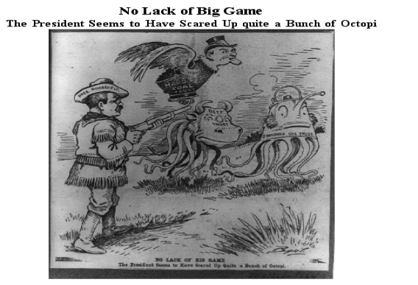
Q=Based on the information provided by the cartoon, President Theodore Roosevelt’s goal was to
A. Persuade businesses to accept nationalization.
B. Assist businesses in resisting interference by investors.
C. Establish worker safety regulations in factories.
D. Use federal power to control monopolies.

Slide 135
Answer
D. Use federal power to control monopolies.

Slide 136
Question #3

Slide 137
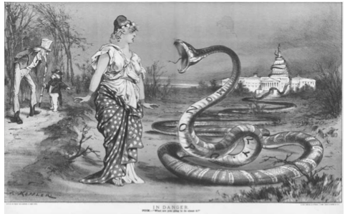
Q=How does the artist believe industry has affected politics in the United States?
A. By expanding the power of political machines.
B. By forcing politicians to seek campaigns contributions.
C. By jeopardizing the legitimacy of the executive branch.
D. By threatening the independence of the legislative branch.

Slide 138
Answer
D. By threatening the independence of the legislative branch

Slide 139
Question #4

Slide 140
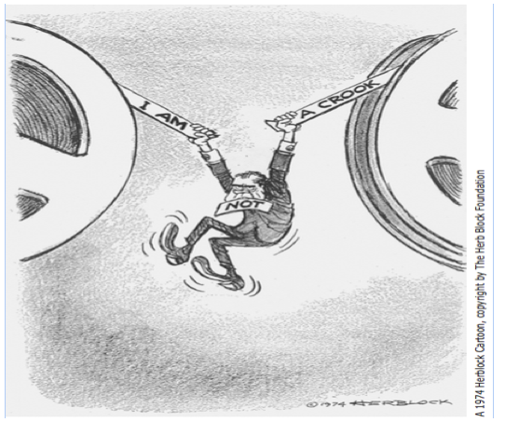
Q=The incident illustrated by this cartoon increased cynicism toward the U.S. government because
A. The press secretary failed to keep the public informed of national policy changes.
B. The president directed a conspiracy to mislead the nation.
C. The Supreme Court overruled statutes that defined confidentiality.
D. Congress failed to pass legislation enforcing protection of privacy rights.

Slide 141
Answer
B. The president directed a conspiracy to mislead the nation.

Slide 142
Question #5

Slide 143
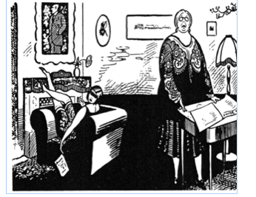
Q= Whose viewpoint is best symbolized in this cartoon?
A. The feminists Lucretia Mott and Elizabeth Cady Stanton
B. The flapper generation of the 1920s
C. The Christian fundamentalist movement of the 1920s
D. The muckrakers of the Progressive Era

Slide 144
Answer
B. The flapper generation of the 1920s

Slide 145
Question #6

Slide 146
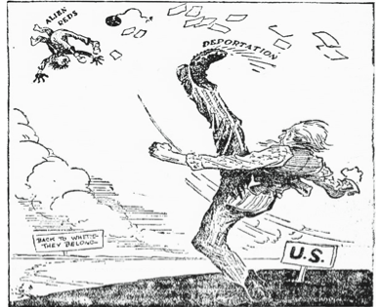
Q=Cartoons such as this one took the position that deportation was necessary because
Assimilation programs in the United States had been unsuccessful.
Economic decline had increased the competition for jobs.
C. Communists were infiltrating the United States.
D. Political Machines had too much power in urban areas.

Slide 147
Answer
C. Communists were infiltrating the United States.

Slide 148
Question #7

Slide 149
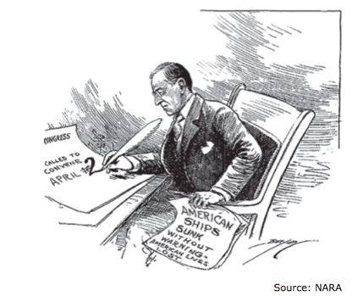
Q=This cartoon depicts President Woodrow Wilson calling on Congress to
Ratify the Treaty of Versailles
Issue a declaration of war against Germany
C. Authorize the use of funds to support Russian revolution
D. Enact trade sanctions against Germany

Slide 150
Answer
B. Issue a declaration of war against Germany

Slide 151
Question #8

Slide 152
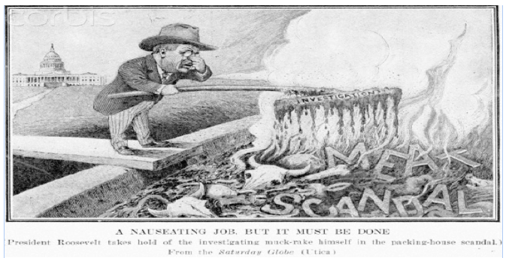
Q=How did President Roosevelt’s response to this scandal influence national policy?
A. The government became involved in protecting individuals from big businesses.
B. The government became involved in providing basic needs for individuals.
C. The government began providing agricultural subsides.
D. The government began protecting natural resources.

Slide 153
Answer
B. The government became involved in providing basic needs for individuals.

Slide 154
Question #9

Slide 155
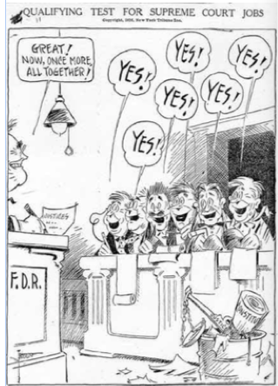
Q=The main idea of the cartoon is that President Franklin D. Roosevelt wanted to
A. Impeach justices who did not support him
B. Control the decisions of the Supreme Court
C. Create higher qualifications for justices
D. Encourage the Supreme Court to act more efficiently

Slide 156
Answer
B. Control the decisions of the Supreme Court

Slide 157
Question #10

Slide 158
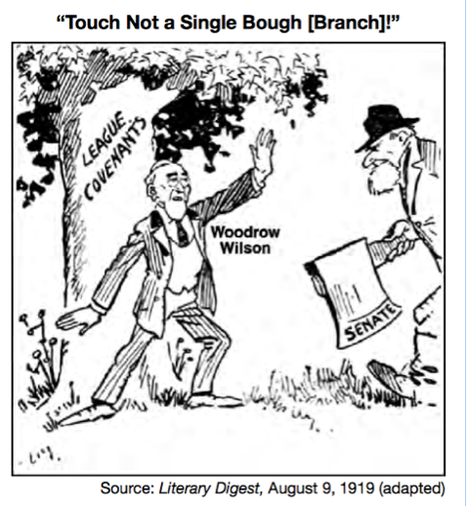
Q=The situation shown in this cartoon was mainly caused by the
A. Disagreement over U.S. participation in the League of Nations
B. Cost of repaying reparations after WWI
C. Failure of President Woodrow Wilson to promote the Treaty of Versailles
D. Overwhelming public rejection of peace terms in the Treaty of Versailles

Slide 159
Answer
A. Disagreement over U.S. participation in the League of Nations

Slide 160
Question #11

Slide 161
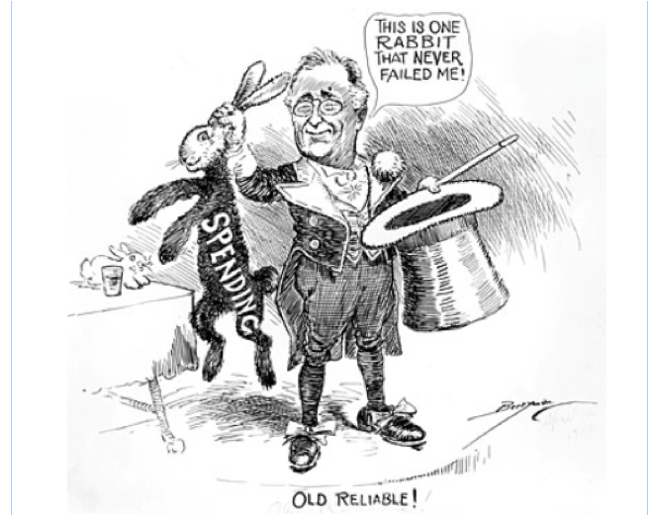
Q=With which idea would the cartoonist agree?
A. President Roosevelt needed to have more control over government spending
B. Deficit spending was underutilized as a way to repair the economy
C. President Roosevelt used many different approaches to solve the Depression
D. Creating jobs through deficit spending gave the illusion of economic growth, but not real recovery

Slide 162
Answer
D. Creating jobs through deficit spending gave the illusion of economic growth, but not real recovery

Slide 163
Question #12

Slide 164
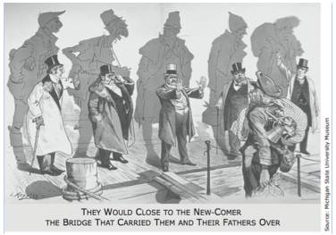
Q=Which group of people most likely inspired the creation of this 1893 cartoon?
A. Union leaders
B. Philanthropists
C. Political bosses
D. Nativist

Slide 165
Answer
D. Nativist

Slide 166
Question #13

Slide 167
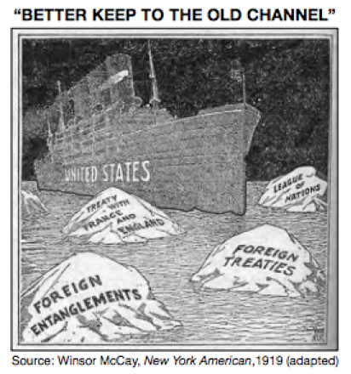
Q=What is the main idea of the cartoon?
A. Travel on ocean-going ships was dangerous and should be banned.
B. The United States should return to an isolationist foreign policy.
C. The U.S. should take the lead in creating an international peacekeeping organization.
D. The U.S. Navy should make efforts to improve its fleet.

Slide 168
Answer
B. The United States should return to an isolationist foreign policy.

Slide 169
Question #14

Slide 170
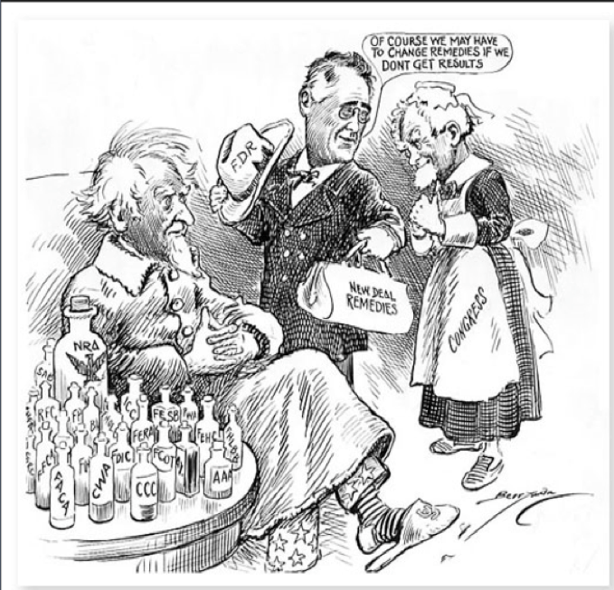
Q=What idea about dealing with the Great Depression is evident in this cartoon?
A. New Deal programs existed primarily to help the elderly receive health care
B. President Roosevelt expanded the government’s role in addressing economic problems
C. Congress and President Roosevelt disagreed on the best way to fix the economy
D. New Deal programs were effective in solving the nation’s economic problems.

Slide 171
Answer
B. President Roosevelt expanded the government’s role in addressing economic problems

Slide 172
Question #15

Slide 173
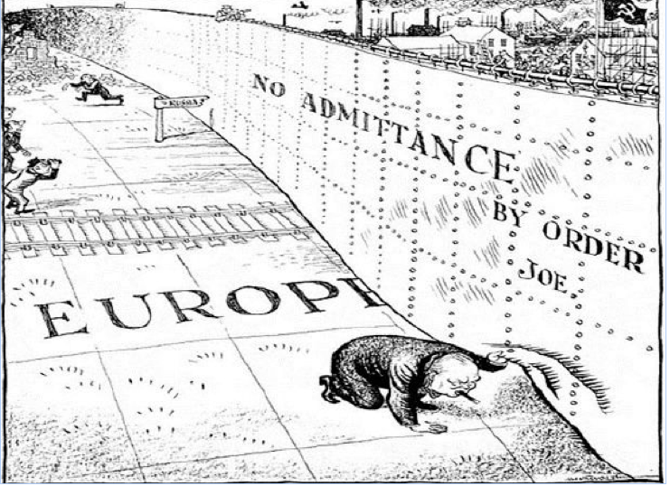
Q=Which aspect of the cold war is illustrated in this political cartoon?
A. A lack of industrial growth with European nations.
B. The willingness of European nations to work together as part of United Nations.
C. The used of convert operations to gain information about communism in Europe.
D. The division of Europe that resulted from opposing political ideologies.

Slide 174
Answer
D. The division of Europe that resulted from opposing political ideologies.

Slide 175
Question #16

Slide 176
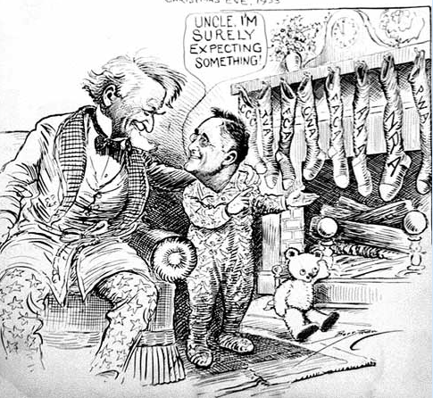
Q=The nickname for FDR’s stockings in this cartoon is
Alphabet Soup
Acronym Soup
Court Packing
Executive Power Soup

Slide 177
Answer
A. Alphabet Soup

Slide 178
Question #17

Slide 179
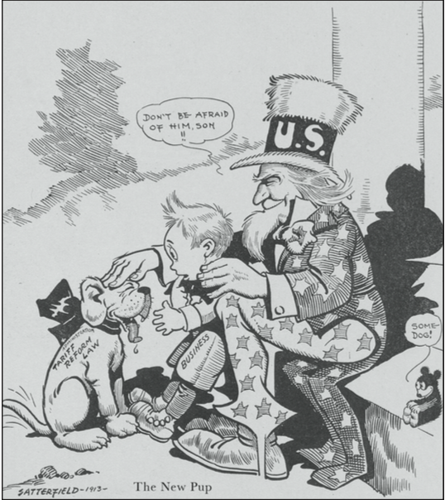
Q=Why would the cartoonist show business as frightened of the tariff?
A. Businesses expected a drop in imports.
B. Businesses envisioned a decline in credit.
C. Businesses assumed an increase in prices.
D. Businesses anticipated an increase in competition.

Slide 180
Answer
D. Businesses anticipated an increase in competition.

Slide 181
Question #18

Slide 182
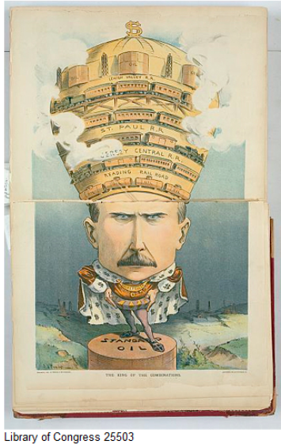
Q=This political cartoon is a criticism of which practice in the 19th century?
A. vertical integration B. monopolization C. industrialism
D. laissez-faire capitalism

Slide 183
Answer
B. monopolization

Slide 184
Question #19

Slide 185
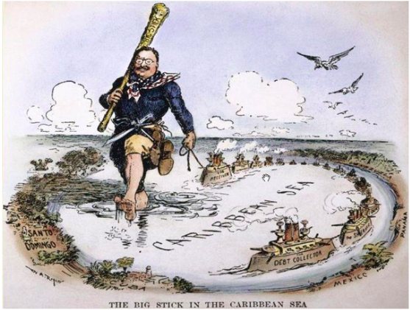
Q=Why does this cartoon depict Roosevelt carrying his “big stick” through the Caribbean?
A. Roosevelt believed that an aggressive foreign policy was needed to prevent Caribbean nations from incurring major debts with European nations. B. Roosevelt believed that a strong military presence in the Caribbean was needed to protect the United States from attack by Latin American nations.
C. Roosevelt felt that the United States had a moral responsibility to protect citizens from civil unrest in Caribbean nations.
D. Roosevelt wanted to seize control of resources available in the Caribbean to promote U.S. business interests.

Slide 186
Answer
A. Roosevelt believed that an aggressive foreign policy was needed to prevent Caribbean nations from incurring major debts with European nations.

Slide 187
Question #20

Slide 188
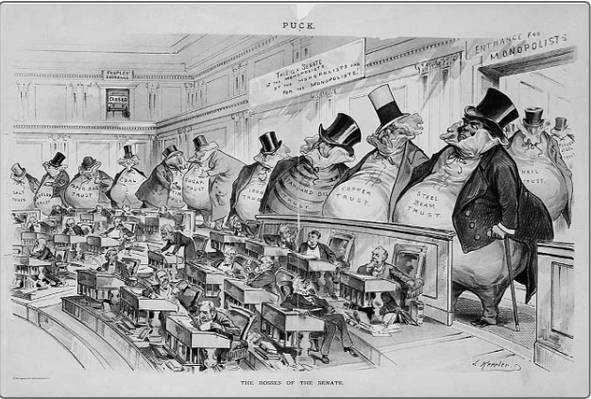
Q=This cartoon suggests that
A. businessmen enjoy watching
Senate debates.
B. businessmen earn more money than Senators.
C. Senators are opposed to business interests.
D. big business is controlling the Senate.

Slide 189
Answer
D. big business is controlling the Senate.

Slide 190
Round 3
40 Short Answer Questions
Worth 5 point
45 sec time limit
Questions will be in Blue and Answer in Red

Slide 191
Question #1

Slide 192
The invasion occurred on April 17, 1961. It did not go well. Although the Cuban air force was damaged by early air strikes, there were still planes left to attack the invaders. Once the invasion started, it took too long for the troops and ammunition to get off the ships. Before the ammunition could be unloaded, Cuban planes sunk the invader's ships. Many of the paratroopers, who were supposed to slow down Castro's forces on the ground, landed at the wrong place or in the swamps. Soon the invaders were surrounded by a much larger force and were running out of ammunition. They tried to retreat, but most were eventually captured and put into prison.

Slide 193
Answer
Bay of Pigs

Slide 194
Question #2

Slide 195
What event happened after Rosa Parks’ arrest in Montgomery, AL?

Slide 196
Answer
Montgomery Bus Boycott

Slide 197
Question #3

Slide 198
What is Executive Order 9906?

Slide 199
Answer
Japanese Citizens Ordered to Interment Camps

Slide 200
Question #4

Slide 201
What is the 16th Amendment?

Slide 202
Answer
Income Tax

Slide 203
Question #5

Slide 204
A White House political scandal that came to light during the 1972 presidential campaign, growing out of a break-in at the Democratic Party headquarters at the Democratic apartment-office complex in Washington, D.C., and, after congressional hearings, culminating in the resignation of President Nixon in 1974.

Slide 205
Answer
Watergate Scandal

Slide 206
Question #6

Slide 207
Nixon’s U.S. policy to end U.S. involvement in Vietnam. This policy gave South Vietnamese responsibility of defeating Viet Cong and North Vietnamese. U.S. still promised air support but no more boots on the ground.

Slide 208
Answer
Vietnamization

Slide 209
Question #7

Slide 210
NAFTA is free trade agreement between which three countries?

Slide 211
Answer
Mexico, United States, and Canada

Slide 212
Question #8

Slide 213
Which government program, during Bill Clinton’s term, provided families with medical services, Day care, job training, and housing subsidies?

Slide 214
Answer
Temporary Assistance for the Needy Families
TANF

Slide 215
Question #9

Slide 216
Which war wanted to liberate Kuwait from Iraq’s Saddam Hussein?

Slide 217
Answer
1st Persian Gulf War in 1991

Slide 218
Question #10

Slide 219
What is another term for Supply-side or trickle-down economics in the 80s?

Slide 220
Answer
Reaganomics

Slide 221
Question #11

Slide 222
Who was the most famous political boss known for his corruption during the Gilded Age?

Slide 223
Answer
Boss Tweed or William Tweed

Slide 224
Question #12

Slide 225
What is Executive Order 9981?

Slide 226
Answer
Desegregation In the Armed Forces

Slide 227
Question #13

Slide 228
Who is the president that is known for Trust busting?

Slide 229
Answer
Teddy Roosevelt

Slide 230
Question #14

Slide 231
What was the policy that allowed the U.S. to trade in China during the early 20th century?

Slide 232
Answer
Open Door Notes or Policy

Slide 233
Question #15

Slide 234
Which Civil Rights group would Stokely Carmichael and Malcolm X most likely be associated with?

Slide 235
Answer
Black Panthers

Slide 236
Question #16

Slide 237
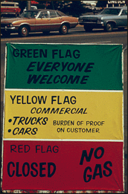
The 1973 oil crisis made Americans realize?

Slide 238
Answer
The U.S. is dependent on foreign oil
U.S. involvement in the Middle East

Slide 239
Question #17

Slide 240
What is the court case that overturned Plessey v Ferguson?

Slide 241
Answer
Brown V Board of Education

Slide 242
Question #18

Slide 243
What did the Civil Rights Act of 1964 accomplish?

Slide 244
Answer
Outlawed segregation in Public accommodation

Slide 245
Question #19

Slide 246
An intelligence war that lasted from 1945-1991. The U.S. and Soviet Union competed for influence throughout the world. Communism versus Democracy.

Slide 247
Answer
Cold War

Slide 248
Question #20

Slide 249
Q= This excerpt deals with what American policy? In considering the requirements for the rehabilitation of Europe, the physical loss of life, the visible destruction of cities, factories, mines, and railroads was correctly estimated, but it has become obvious… that this … was probably less serious than the dislocation of the entire fabric of European economy.

Slide 250
Answer
Marshall Plan

Slide 251
Question #21

Slide 252
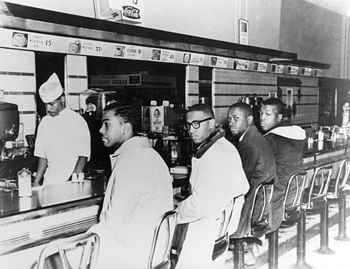
Q=Which Civil Rights strategy is being used in this picture?

Slide 253
Answer
Sit-In

Slide 254
Question #22

Slide 255
Name the most successful Civil Rights group that attacked the legal system?

Slide 256
Answer
NAACP

Slide 257
Question #23

Slide 258
What is the 17th Amendment?

Slide 259
Answer
Direct election of senators

Slide 260
Question #24

Slide 261
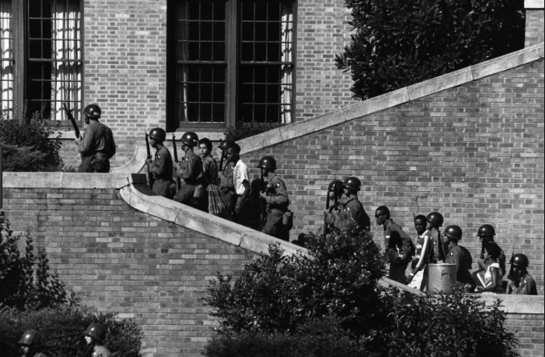
What is this U.S. event?

Slide 262
Answer
Little Rock 9

Slide 263
Question #25

Slide 264
What is the 18th Amendment?

Slide 265
Answer
Prohibition
No Diet Cokes

Slide 266
Question #26

Slide 267
What were the modern women in the 1920s called?

Slide 268
Answer
Flapper

Slide 269
Question #27

Slide 270
What is the 24th Amendment?

Slide 271
Answer
Elimination of poll tax

Slide 272
Question #28

Slide 273
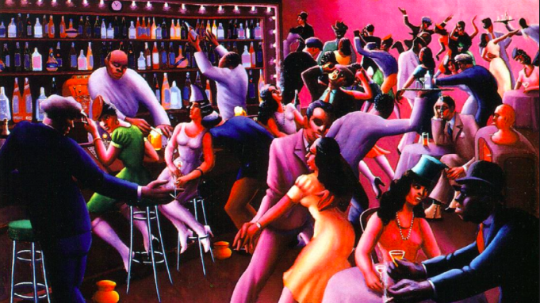
What does this picture represent?

Slide 274
Answer
Harlem Renaissance

Slide 275
Question #29

Slide 276
Answer

Slide 277
Question #30

Slide 278
Answer

